Slide 1
BLINKIT DATASET
QUANSAH ABAIDOO MESHACH

Slide 2
INTRODUCTION
Hello And Welcome. In Today’s Presentation, I Am Excited To Take You Through This Bike Share Dataset.
I Am Really Excited To Be Doing This Presentation As It Has Given Me The Opportunity To Dive Into, And Gain Insightful Information About This Special Project

Slide 3
ABOUT ME
Hola, My Name Is Quansah Abaidoo Meshach, A Data Analyst And I Am Here Today To Take Us Through This Wonderful Presentation. Being A Data Analyst Hasn’t Being Easy Especially For Someone Without A Background In Computer Science Or Anything Relating To Data. However By The Grace Of God, Here We Are After 6 Solid Months. I Do Hope You Enjoy This Presentation And Oh Yh Let’s Have Fun Doing What We Love The Most. Let’s Goooooo

Slide 4
PROCESS
I am excited to state that, I took the necessary process in ensuring that this project has passed through the necessary steps and procedure before finally arriving at the final result.
First, I checked my individual columns for errors. I discovered during this phase that, Item fat content column contain errors so I worked on it by changing all “low fats”and “LFs” to “Low Fat” since its all the same. I then changed all “reg” to “Regular”. Before proceeding to load the data into power BI for my analysis and visuals.
I showcased a few of the visuals I got from my insights, the rest are in the form of slicers or cards.

Slide 5
BUSINESS QUESTIONS/KPIs
Total sales by item type
Sales by item fat contENT and outlet type
Total sales by outlet size
Sales by outlet location type
SALES BY ITEM FAT CONTENT
SALES BY OUTLET ESTABLISHMENT YEAR
AVERAGE SALES AND AVERAGE RATING BY ITEM TYPE
AVERAGE RATING
AVERAGE SALES
NUMBER OF ITEMS
TOTAL SALES

Slide 6
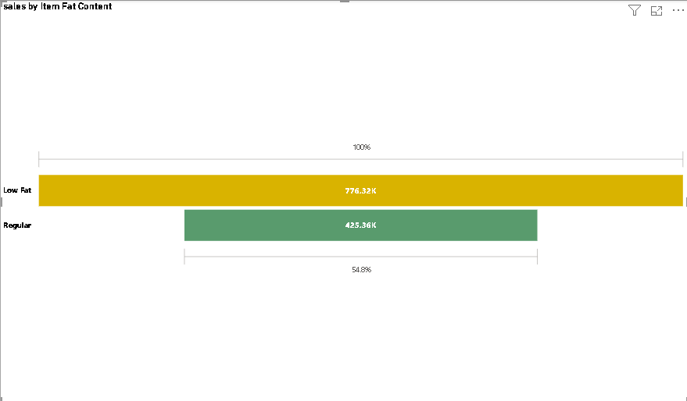
SALES BY ITEM FAT CONTENT
Here, we can se that low fat content items are in highdemand as against regular fat content items telling management to produce more of the low fat items as it is more preferred as against the regular fat content items

Slide 7
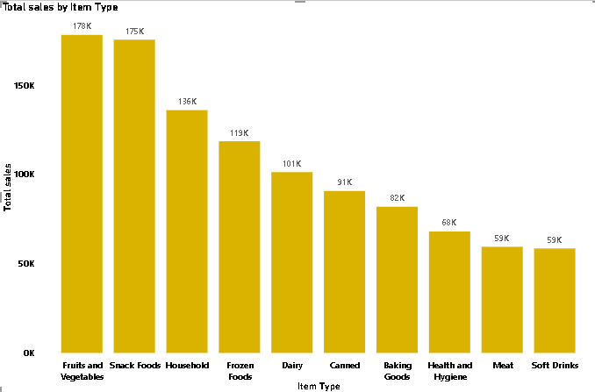
TOP 10 TOTAL SLES BY ITEM TYPE
At 178,124.08, Fruits and Vegetables had the highest Total sales and was 204.41% higher than Soft Drinks, which had the lowest Total sales at 58,514.17.
Fruits and Vegetables accounted for 16.68% of Total sales.
Across all 10 Item Type, Total sales ranged from 58,514.17 to 178,124.08

Slide 8
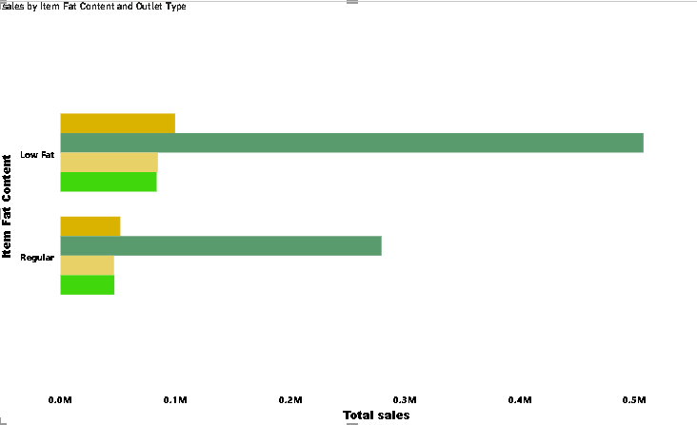
SALES BY ITEM FAT CONTENT AND OUTLET TYPE
Supermarket Type1 had the highest total Total sales at 787,549.89, followed by Grocery Store, Supermarket Type2, and Supermarket Type3.
Low Fat in Outlet Type Supermarket Type1 made up 42.26% of Total sales.
Supermarket Type1 had the highest average Total sales at 393,774.95, followed by Grocery Store, Supermarket Type2, and Supermarket Type3.

Slide 9
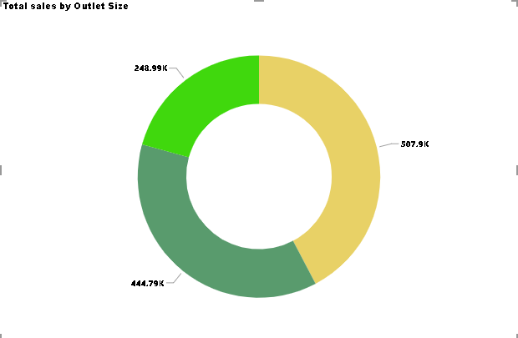
TOTAL SALES BY OUTLET SIZE
Medium had the highest Total sales at 507,895.74, followed by Small at 444,794.17 and High at 248,991.59.
Medium accounted for 42.27% of Total sales.

Slide 10
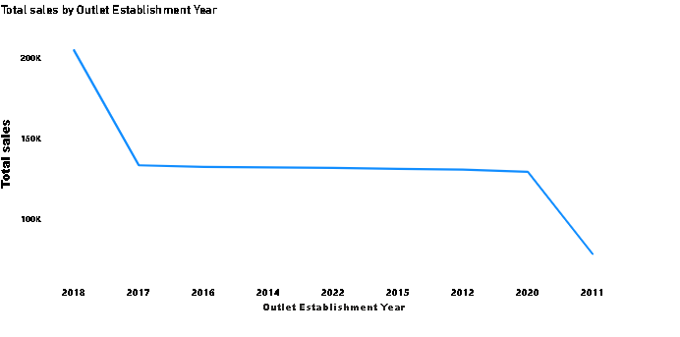
TOTAL SALES BY OUTLET ESTABLISHMENT YEAR
This line chart clearly shows how sales increase significantly from the 2017-2018.

Slide 11
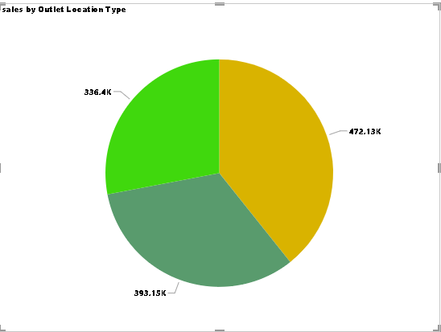
SALES BY OUTLET LOCATION TYPE
Tier 3 had the highest Total sales at 472,133.03, followed by Tier 2 at 393,150.65 and Tier 1 at 336,397.81.
Tier 3 accounted for 39.29% of Total sales.

Slide 12
THANK YOU

